Slide 1
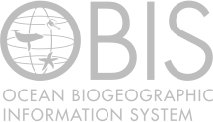
Ocean Biogeographic Information System a biodiversity data sharing platform and clearing house
Ward Appeltans
OBIS secretariat
IOC Project Office for IODE
BBNJ SIDS Workshop, 7-9 march 2017, belgium

Slide 2
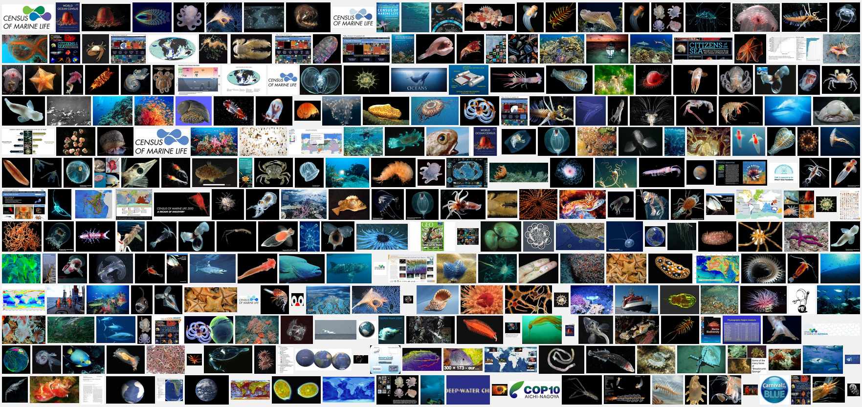
Census of Marine Life
Notes:
OBIS started under the Census of Marine Life. A 10 year programme to document what lived, lives and will live in the Ocean. OBIS is the data legacy of the Census.

Slide 3
IOC Member States: “Knowledge of the ocean’s biodiversity is of such importance to national and global environmental issues that the responsibility for OBIS’ continuing success should be assumed by governments”
2000
2009
27 nodes
600 institutions
47 million observations
120,000 marine species
Project of IODE in 2011
Notes:
The funding from the Sloan Foundation ended in 2010, and OBIS was then adopted by the IOC Member States, as a project of IODE. OBIS is now world’s largest open-access database with 47 M observations of nearly 120,000 marine species, provided by 600 institutions world wide.

Slide 4
"To build and maintain a global alliance that collaborates with scientific communities to facilitate free and open access to, and application of, biodiversity and biogeographic data and information on marine life."
Arctic OBIS
AntOBIS
OBIS Canada
OBIS HAB
iOBIS
OBIS USA
OTN
EurOBIS
Black Sea OBIS
OBIS China
MicrOBIS
FishBase
MedOBIS
OBIS Japan
OBIS SEAMAP
PEGO-OBIS
Seamounts Online
OBIS Senegal
KOBIS
Caribbean OBIS
Oceans Past
IndOBIS
ESPOBIS
WSAOBIS
AfrOBIS
OBIS Australia
ArOBIS
South Western Pacific OBIS
Notes:
The data from these 600 institutions is provided to OBIS through more than 20 national, regional or thematic OBIS nodes. They standardize and quality control the data, so OBIS can easily integrate them in a single database. The central system is maintained here at the OBIS secretariat in Oostende.

Slide 5
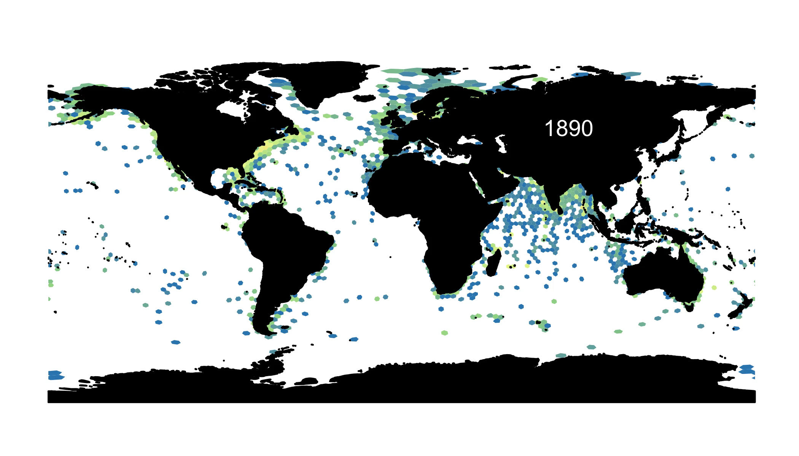

Slide 6
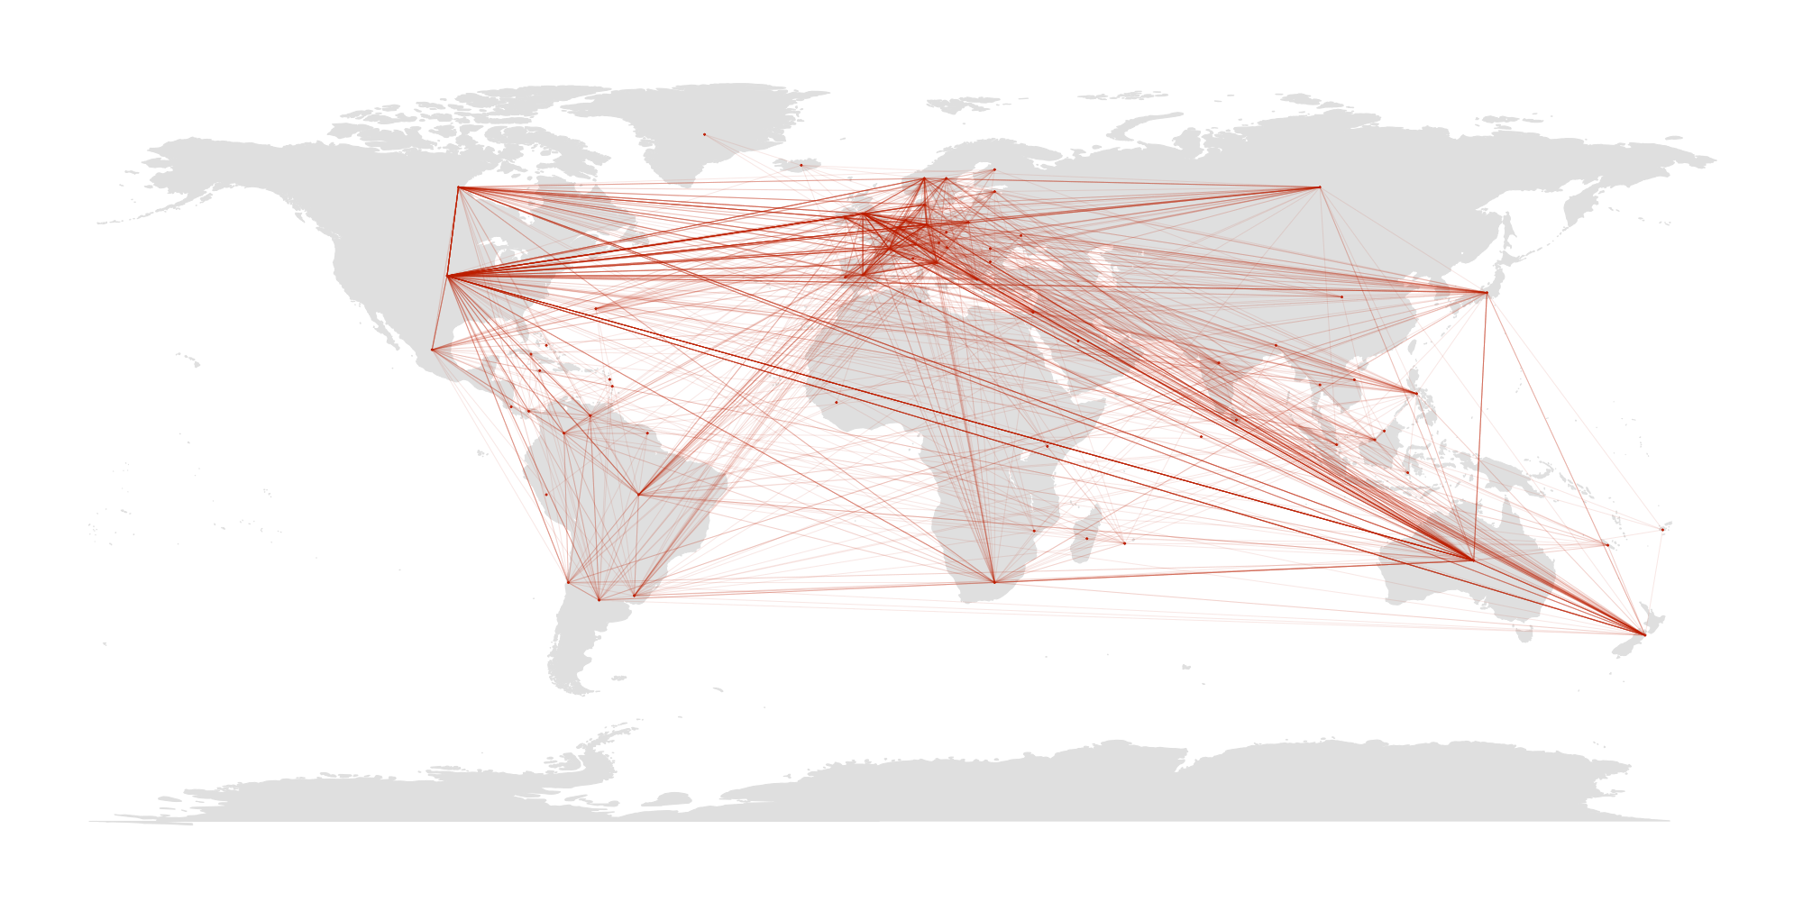
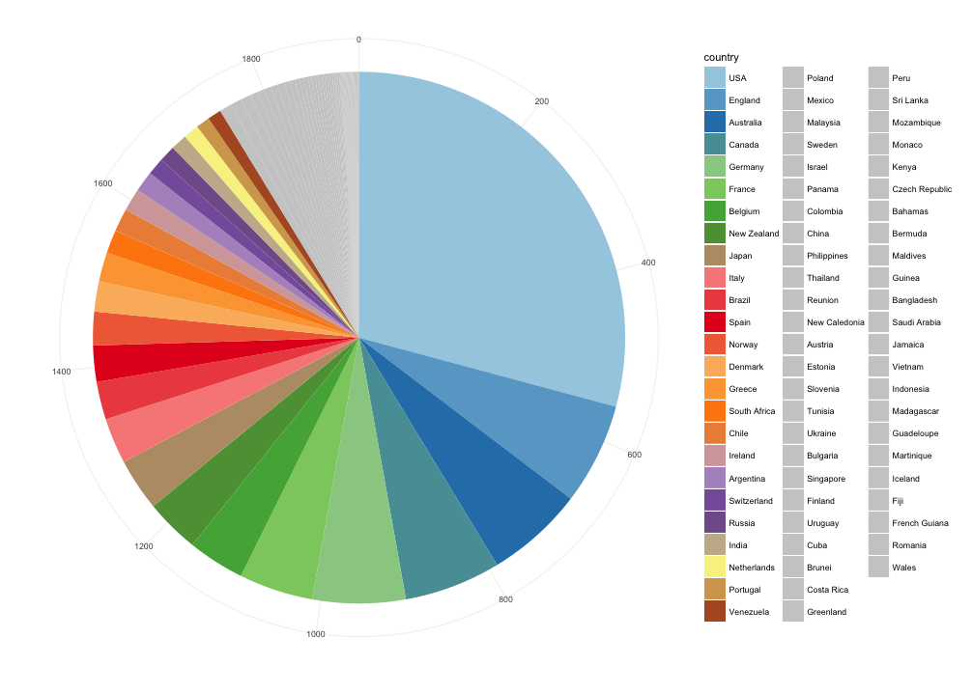
Scientists from 73 countries used OBIS in >1,000 research publications
A/RES/70/235
A/RES/69/245
Through open-access to data, OBIS provides equitable access and benefits to research and enhances international collaboration.
Connections of >500 co-authored papers citing OBIS (Web of Science)
Notes:
So far, more than 1000 papers have cited OBIS. This graph shows the connections of the co-authors on each of these papers. Interestingly, there are not only N-N but also N-S and S-S connections. Through open-access to data, OBIS provides equitable access and benefits to research and enhances international collaboration. OBIS contribution to Marine Scientific Research is recognized by the United Nations General Assembly.

Slide 7
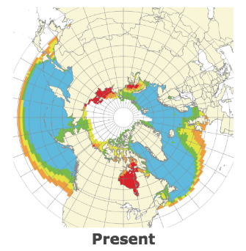
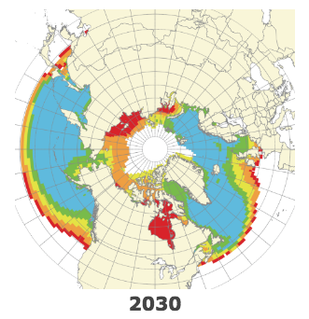
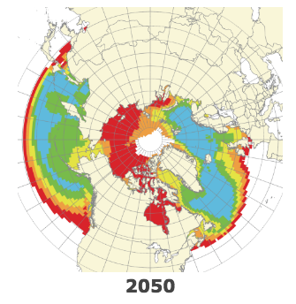
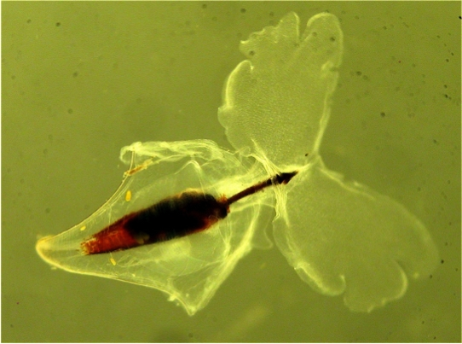
OBIS Science Applications
Developing a new species trend index
Predicting the impact of ocean acidification on pteropods in the Arctic
Percentage of change in mean species occupancy compared to a pre-1985 baseline, finding a ~22% decrease in site occupancy by Celtic Sea molluscs since 1985
Pteropods or ‘Ocean butterflies’, are a food source for fish, and have a key ecological role in polar ocean ecosystems
Habitat-based cetacean density models for the U.S. Atlantic and Gulf of Mexico
Systematic biodiversity change - global reorganisation of species pools
A global study based on time series datasets from OBIS published in Science in 2014 detected temporal species community composition change, not systematic loss of diversity.
Notes:
Because the data is freely available, many scientists are building applications. A few use cases are for example, a new species trend indicator based on site occupancy modeling, changes in species composition, the impact of ocean acidification on polar species, and marine mammal density models which inform the government on when certain activities should be stopped.

Slide 8
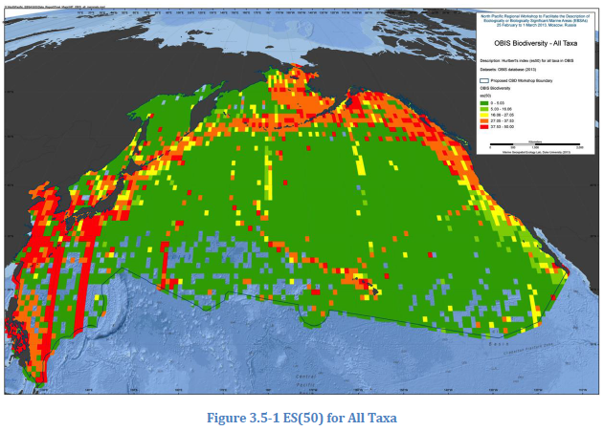
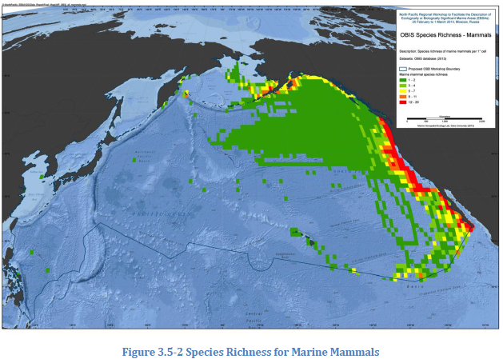
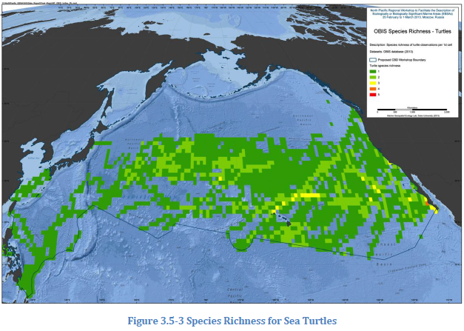
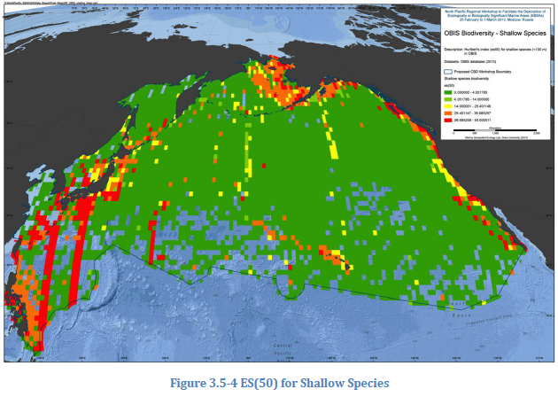
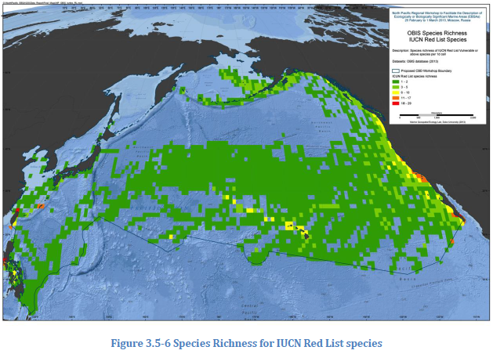
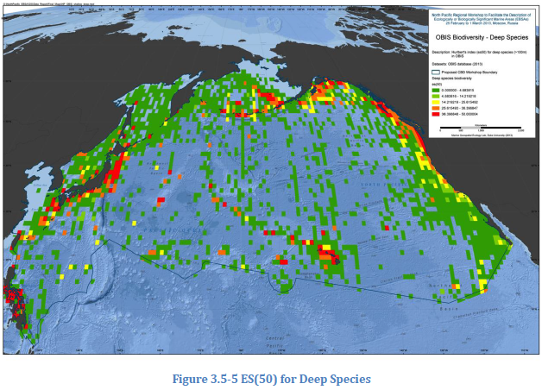
OBIS contributions to the CBD EBSA process
North Pacific regional EBSA workshop, Moscow,
25 Feb – 1 March 2013
In 2010, the CBD Conference of the Parties (COP, decision X/29, paragraph 36) asked IOC, through its OBIS, to provide scientific and technical support to the CBD secretariat in convening a series of regional workshops on EBSAs
Notes:
OBIS is also a major source of information for the identification of Ecologically or Biologically Signifcant Areas in the high seas. A process led by the Convention on Biological Diversity. The CBD/COP explicitly asked IOC, through OBIS, to provide scientific and technical support.

Slide 9
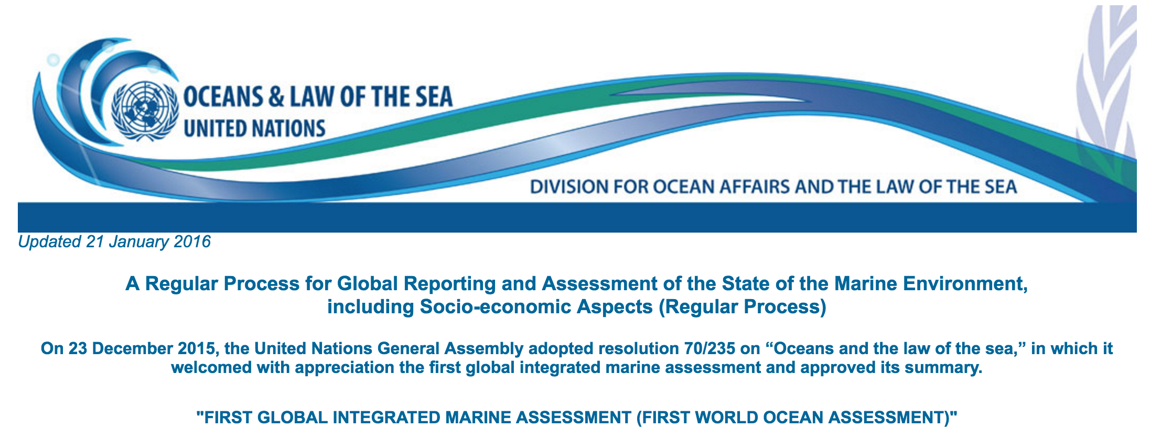
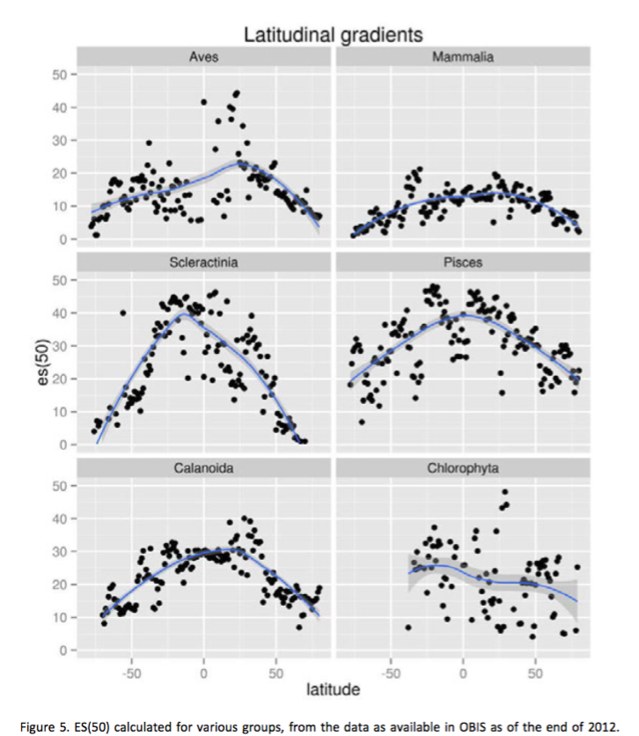
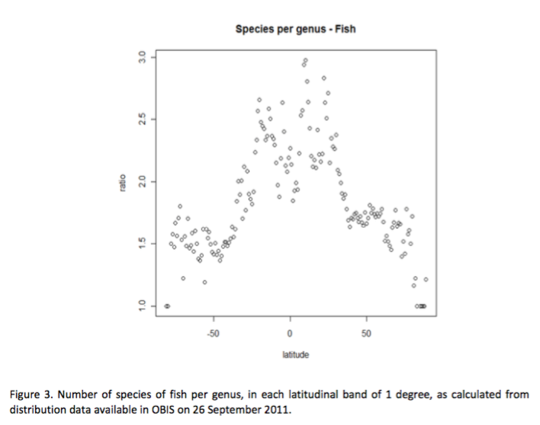
OBIS is a supporting data system for the First World Ocean Assessment
Notes:
OBIS data was used in 3 chapters of the first UN World Ocean Assessment.

Slide 10

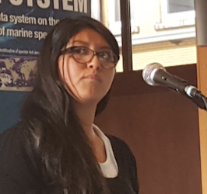
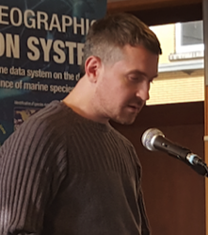
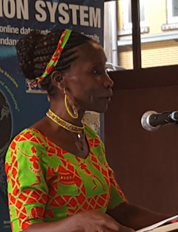
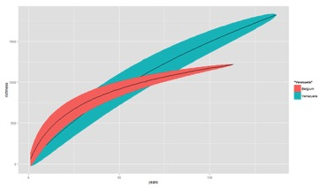
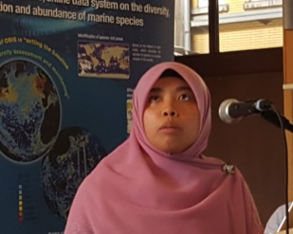
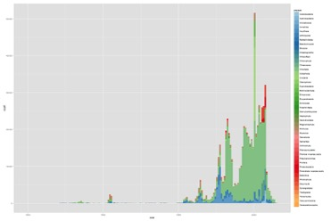
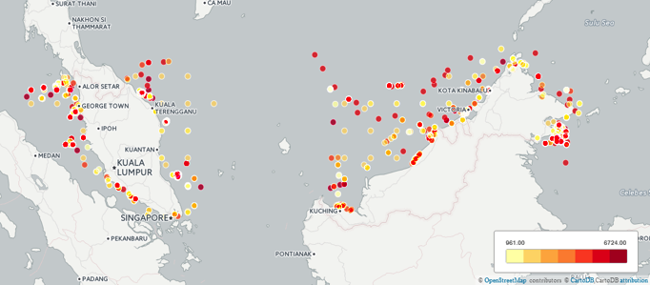
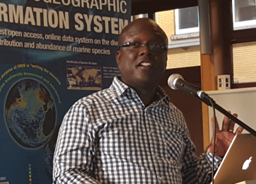

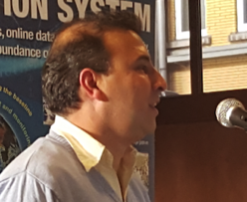
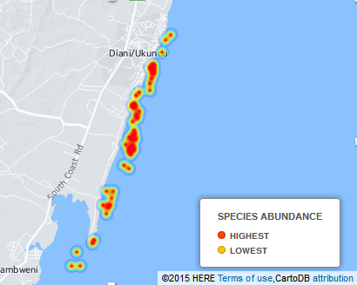
Capacity Development
Mexico
Ukraine
Data cleaning
Data formatting
Data publication
Data access
Data visualisation
Data analysis
Tanzania
Malaysia
USA
Malaysia
Indonesia
South
Africa
Argentina
Kenya
Venezuela
Connecting People
Colombia
Notes:
Training scientists from all over the world, to contribute to OBIS and analyse data from OBIS is a core activity of the OBIS secretariat. Also the OBIS nodes are training more and more people. These trainings use the OceanTeacher learning platform.

Slide 11
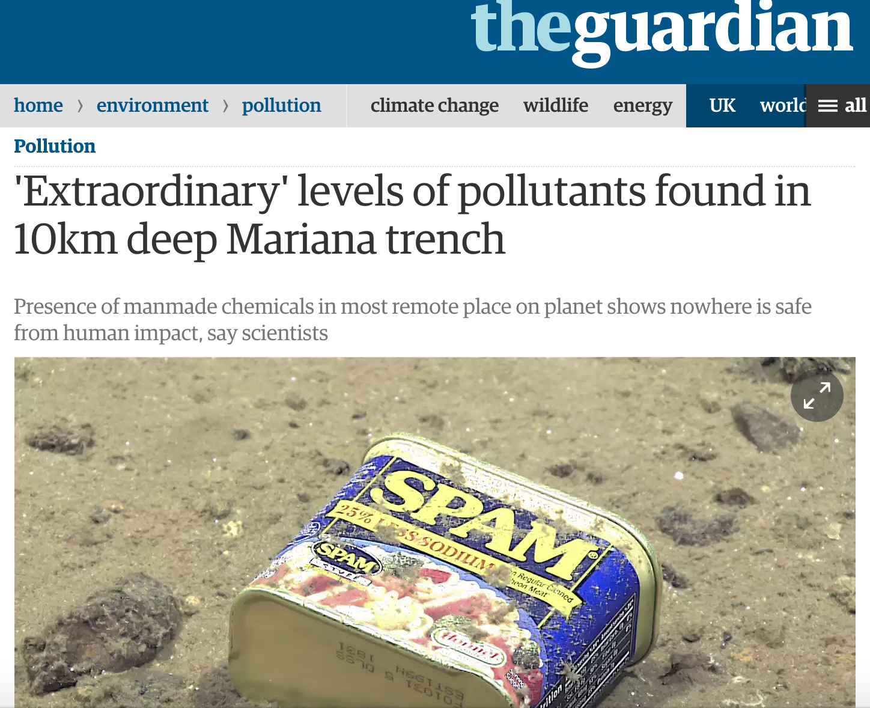
Notes:
Our impact on the ocean, even in the deepest places, is far greater than we thought. A few weeks ago, this study appeared that shows that manmade chemicals were found in marine life at 10km deep.

Slide 12
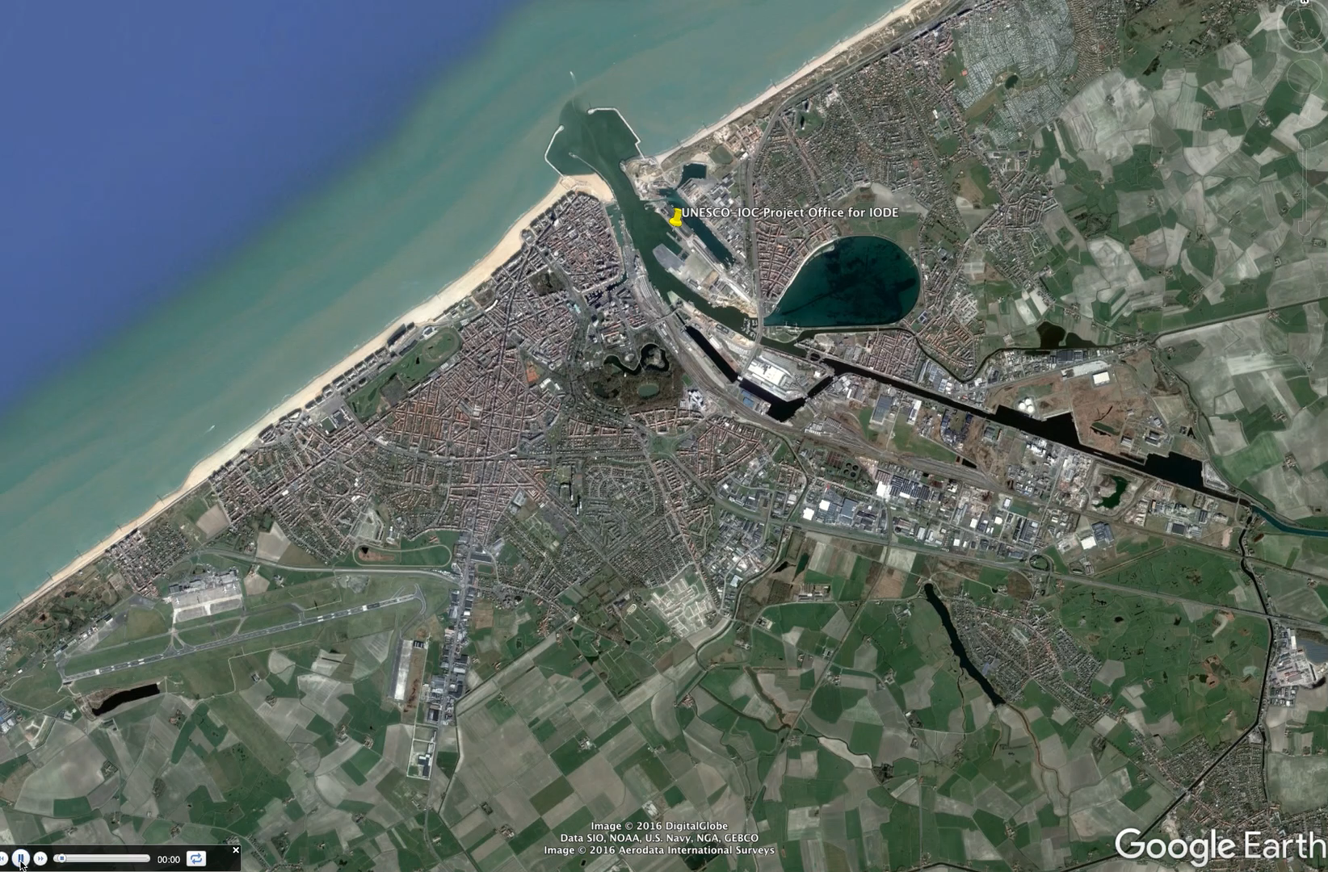
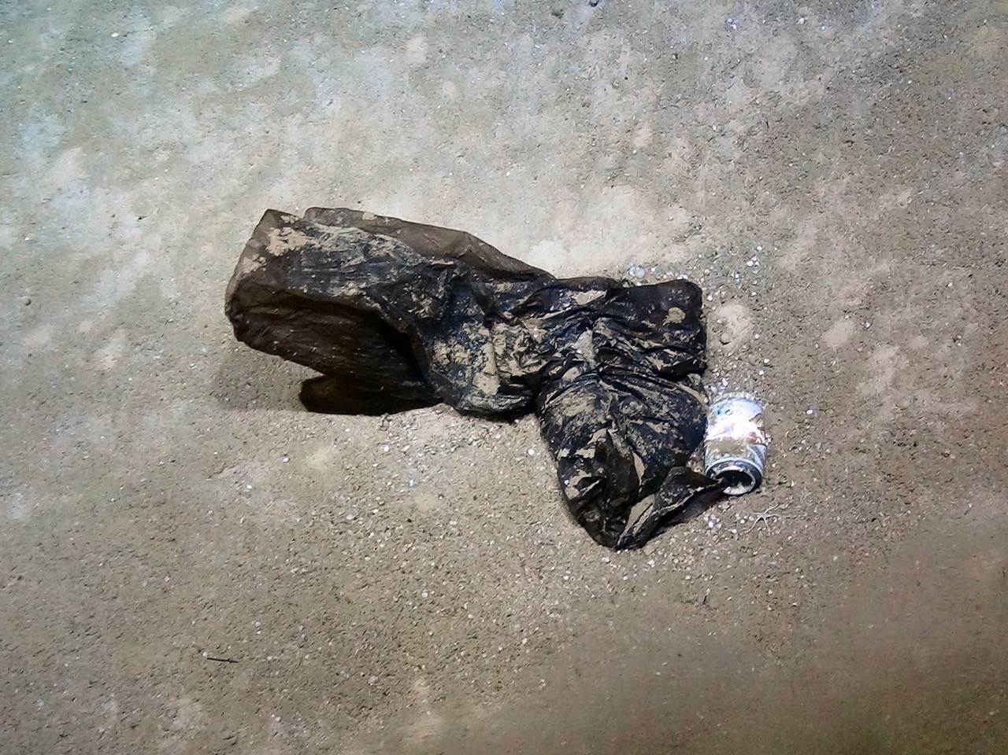
Credits: Jon Copley Univ. of Southampton
Notes:
A colleague shared this image of a plastic bag and beer can. You may think this is a picture of our beach. Is it not. This is a picture of 2300m depth in the mid-cayman spreading centre in the Caribbean. close to the Von Damm Vent field.

Slide 13
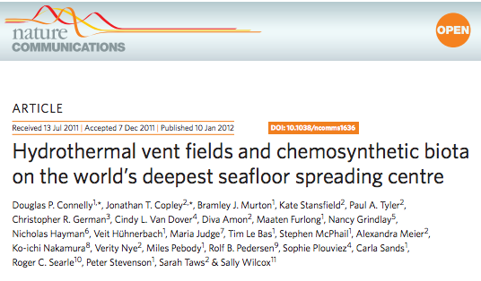
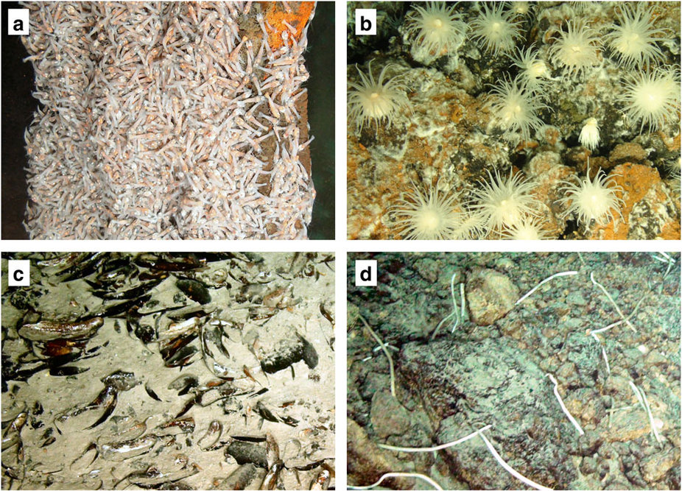
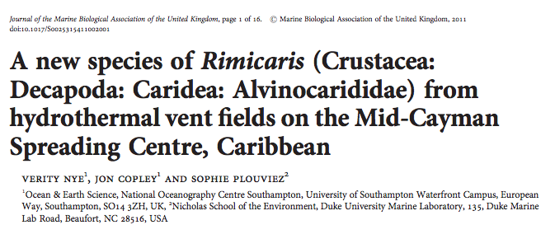
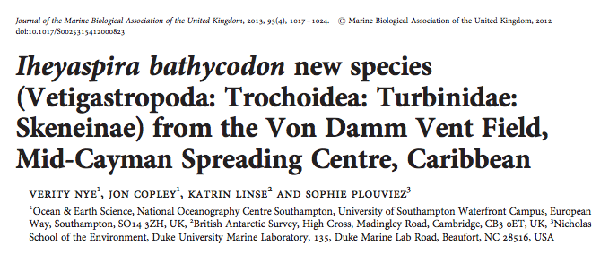
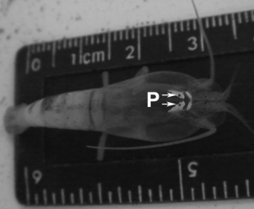
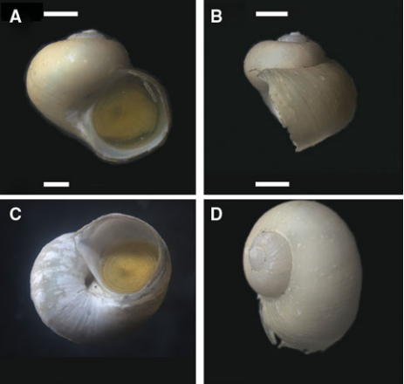
Rimicaris hybisae Nye, Copley & Plouviez 2012 (world's deepest known vent shrimp)
Iheyaspira bathycodon Nye, Linse, Copley & Plouviez 2013 (deep-sea snail)
Notes:
I searched a bit about this site on google and found an article about this hydrothermal vent published in Nature in 2011, showing a wealth of specialized chemosynthetic biodiversity. Some further reading, showed that 2 new species were recently discovered on this site and published in 2012 and 2103. A world’s deepest known vent shrimp and a deep-sea snail. Now let’s see if OBIS has some data from this area.

Slide 14
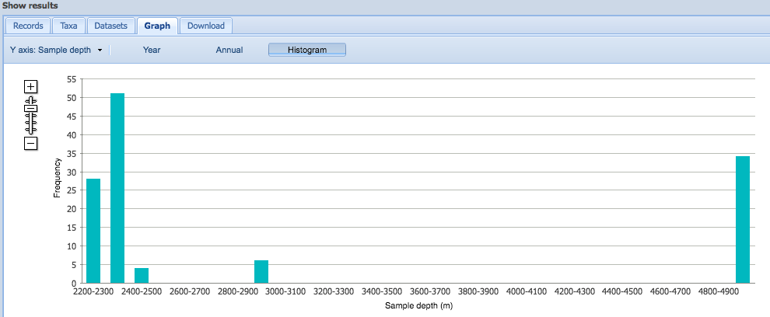
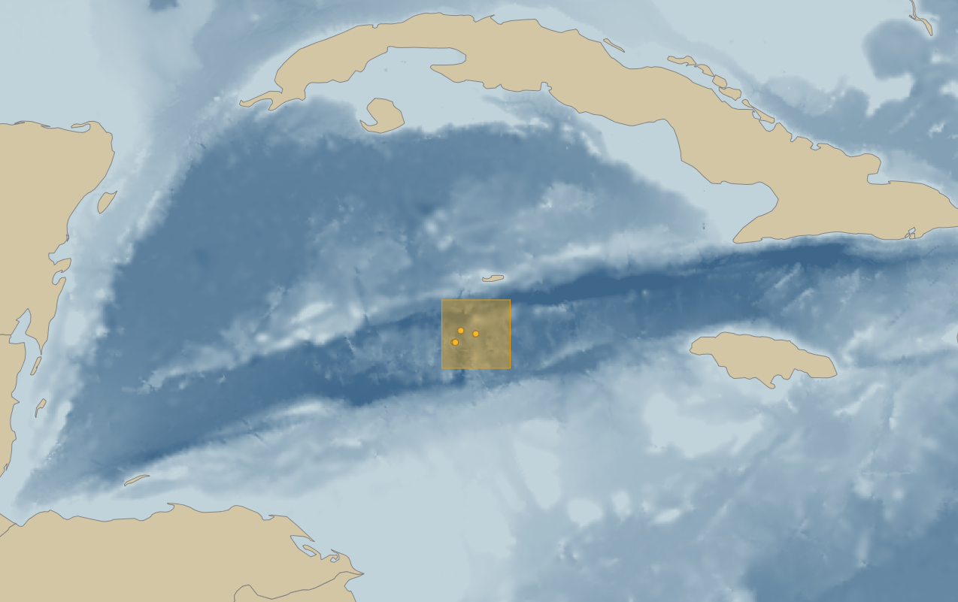
http://iobis.org/mapper/
131 observations
38 taxa
7 datasets
Notes:
Using the OBIS mapping tool, OBIS has 131 observations of 38 taxa from 7 datasets. The deep records are from 2200m to 4900m depth.

Slide 15
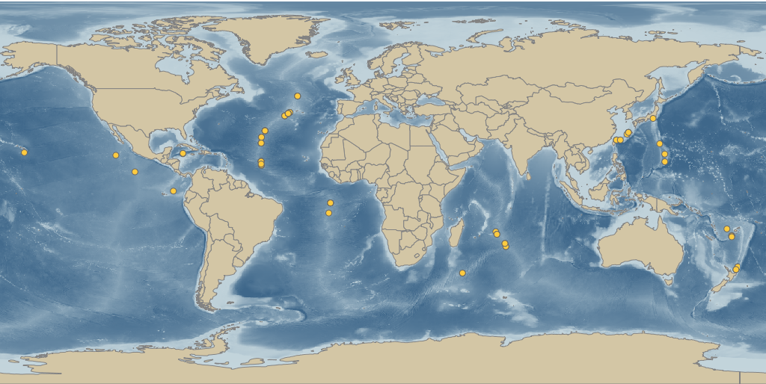

Distribution of Hydrothermal Alvinocaridid Shrimps from NIWA (NZ)
Marine Biological Sample Database, JAMSTEC (JAPAN)
Notes:
The deep-sea records come from 2 datasets, a shrimp dataset from New Zealand and a dataset from Japan, who seems to have made a special trip to the Caribbean to visit this site.

Slide 16
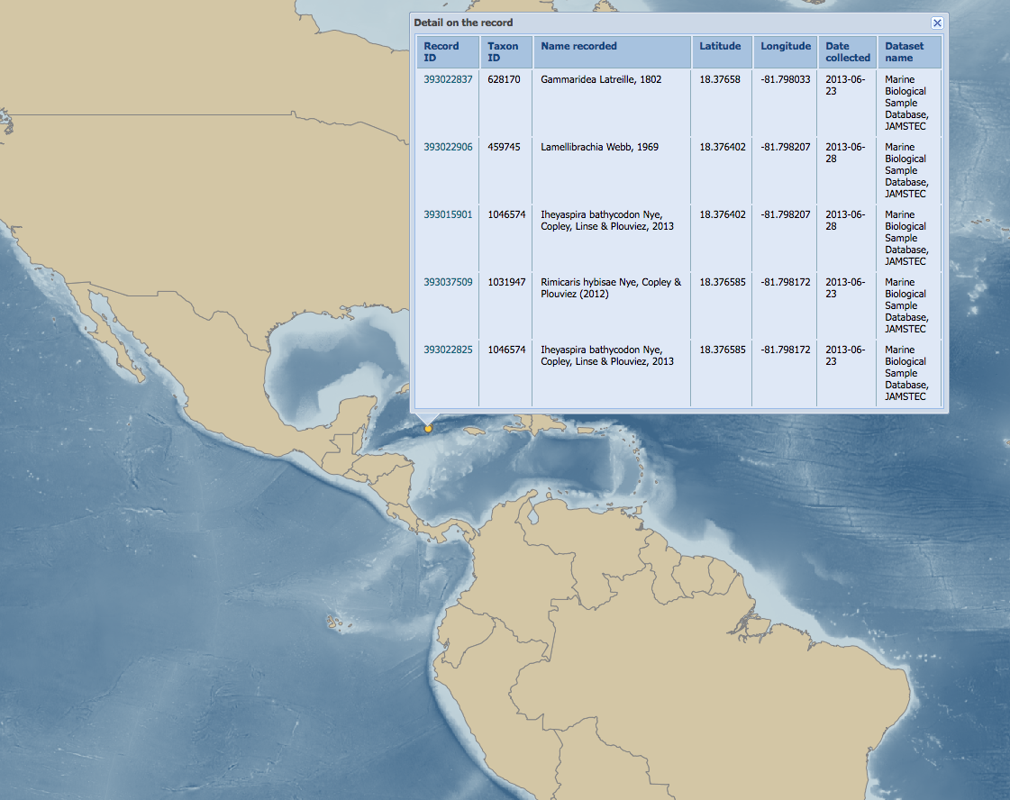
OBIS contains
36 records of Rimicaris hybisae Nye, Copley & Plouviez, 2012
12 records of Iheyaspira bathycodon Nye, Copley, Linse & Plouviez, 2013
Collected by JAMSTEC, with visiting UK scientists, in June 2013
Notes:
Looking at the records, OBIS has 36 records of the deepsea shrimp and 12 records of the deep-sea mollusc collected in 2013. Those new species were found again one year after they were described for the first time by an expedition from JAMSTEC with visiting UK scientists on-board.

Slide 17
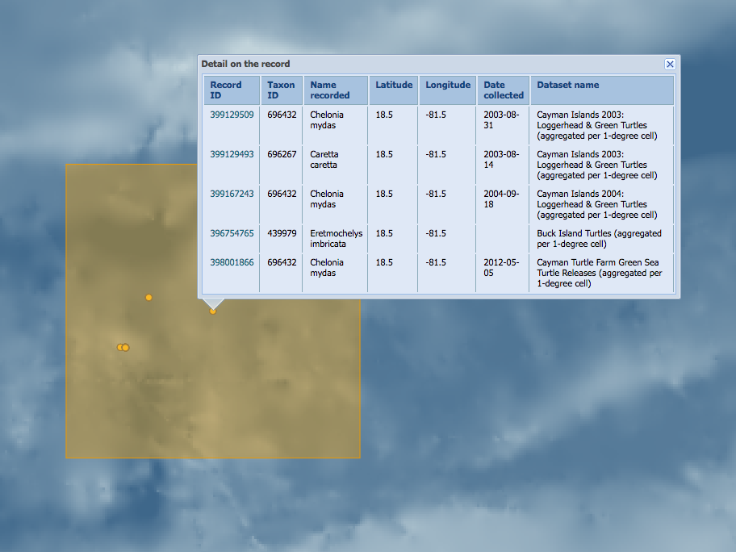
Green turtle, picture from EOL
Notes:
Not only deep-sea species occur in this area of the Caribbean. We also have some records of the green turtle.

Slide 18
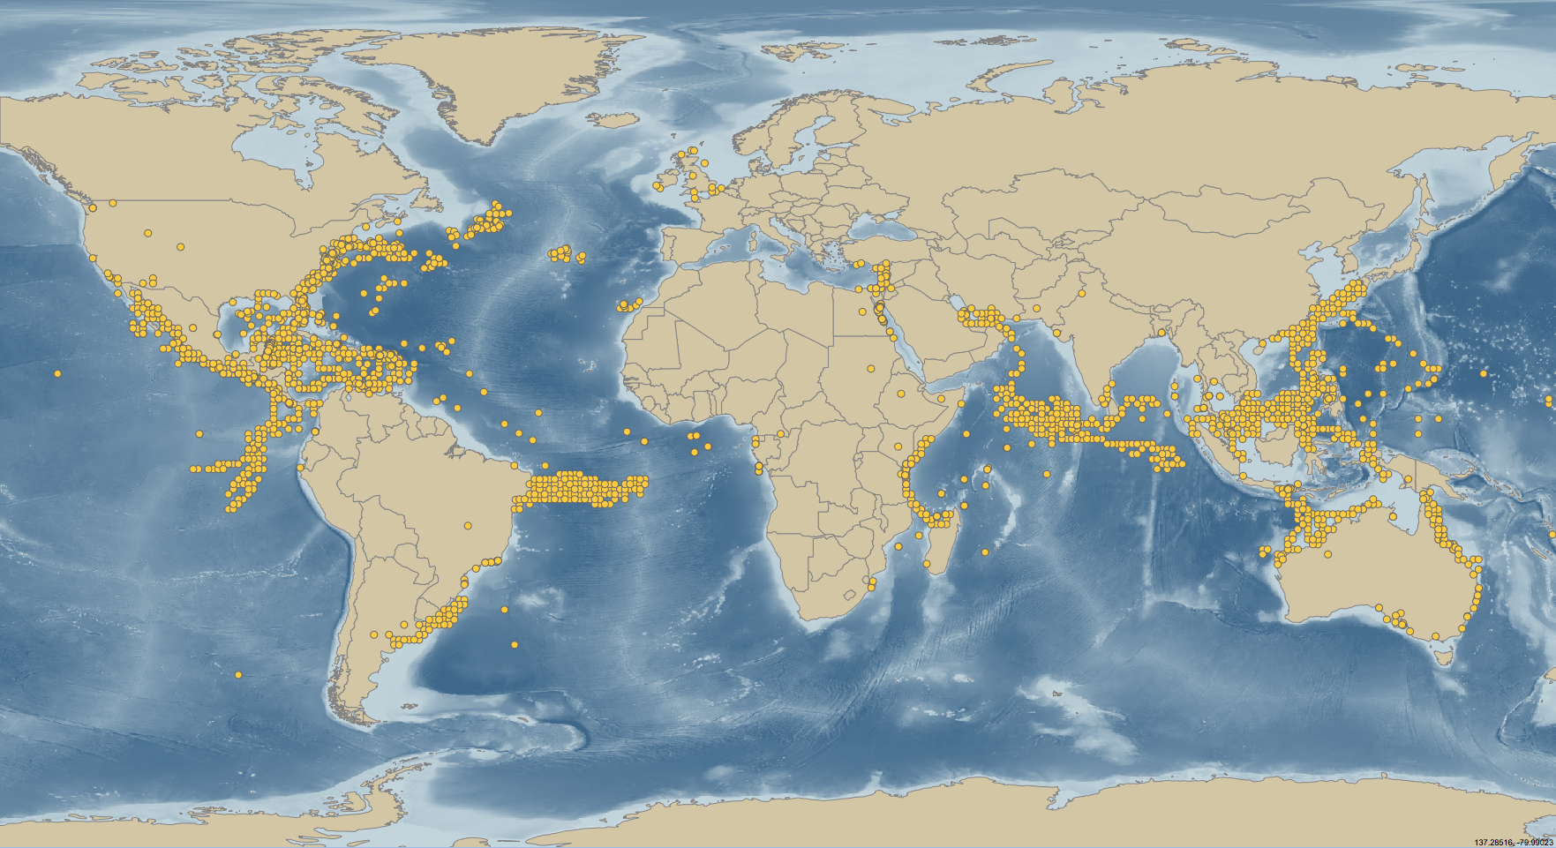
Notes:
The green turtle is a cosmopolitan species, that migrates within and beyond areas of national jurisdiction. It is a species that is considered endangered on the IUCN Red List. BBNJ not only concerns deep-sea species but also species that live in the open pelagic.

Slide 19
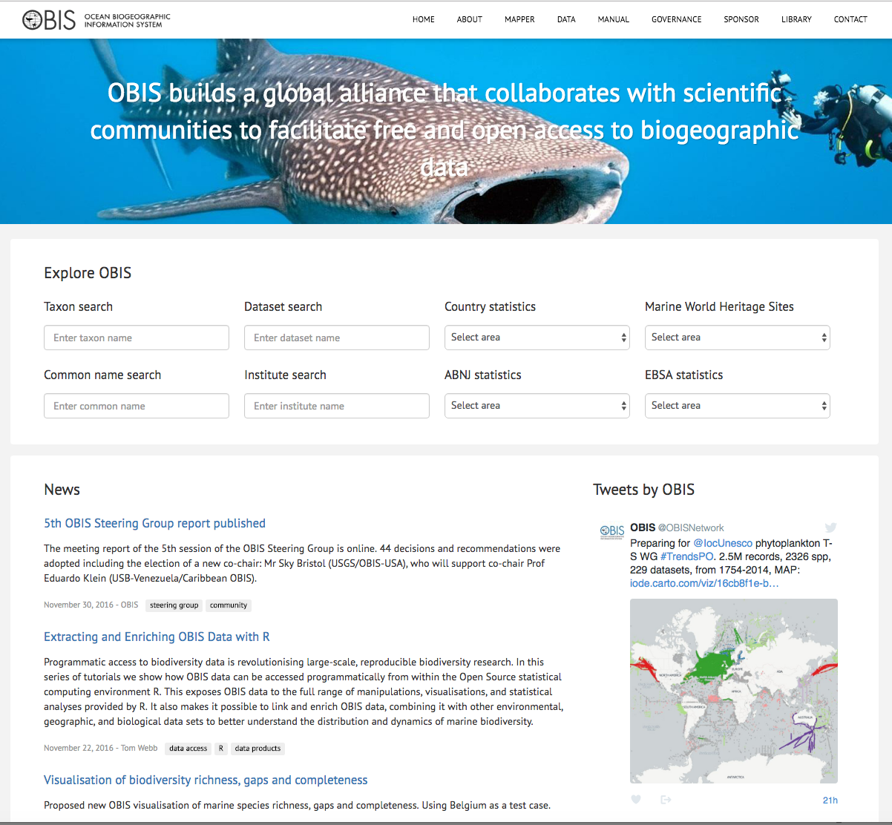
www.iobis.org
Notes:
Half a year ago, OBIS has launched a new portal. This is a user-friendly website where you can easily discover what data and information OBIS provides for species, and areas such as by country, or ABNJ and world heritage sites.

Slide 20
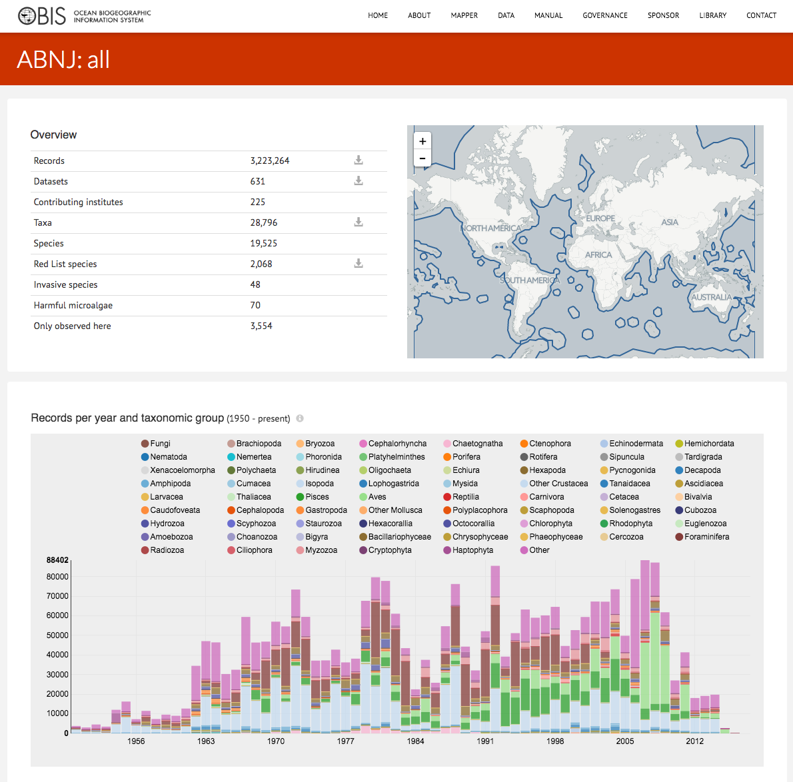

Slide 21
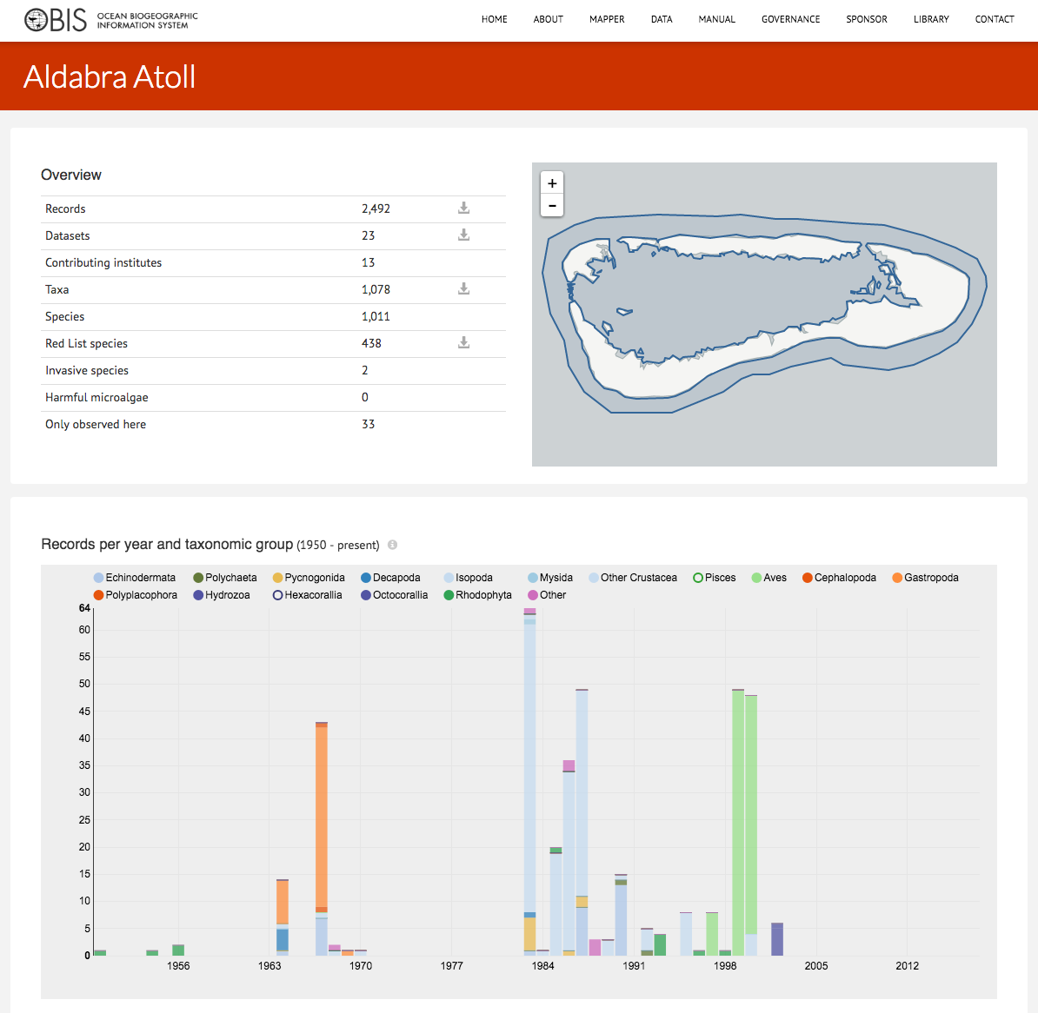
Notes:
For example, OBIS has about 2500 observations from 1000 species in the Aldabra Atoll, from 23 datasets provided by 13 institutions. Interestingly, 33 species are only reported from this area. So could be unique to the Aldabra Atoll. The portal provide some further graphs…

Slide 22
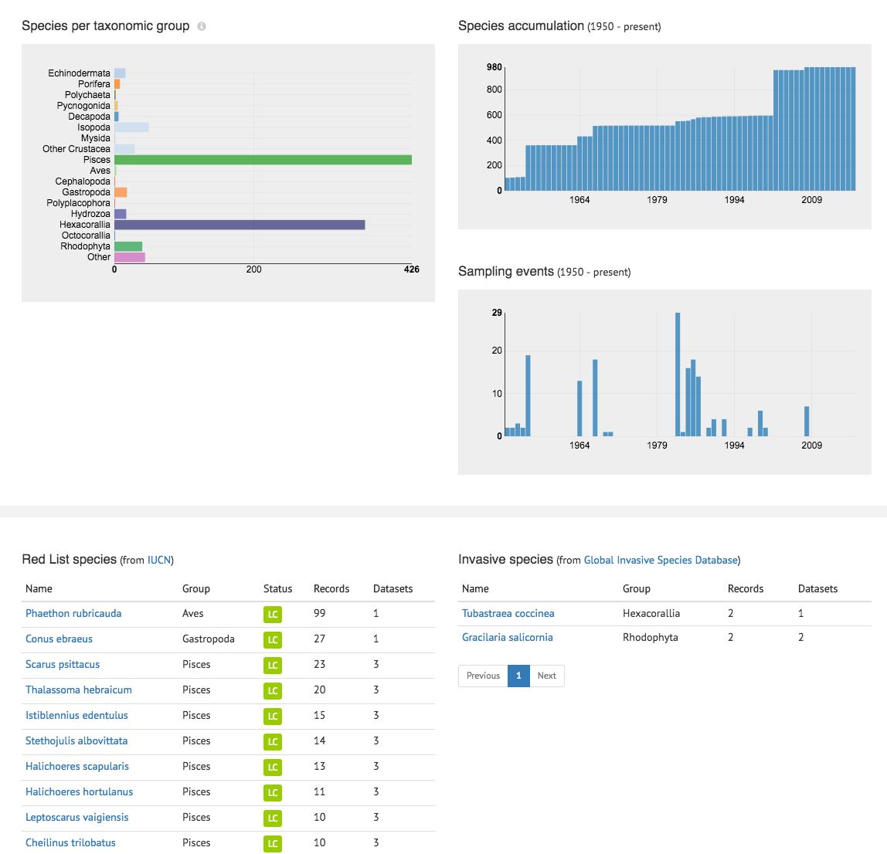
Notes:
Such as species per taxonomic groups, species accumulation curves, red list species,

Slide 23
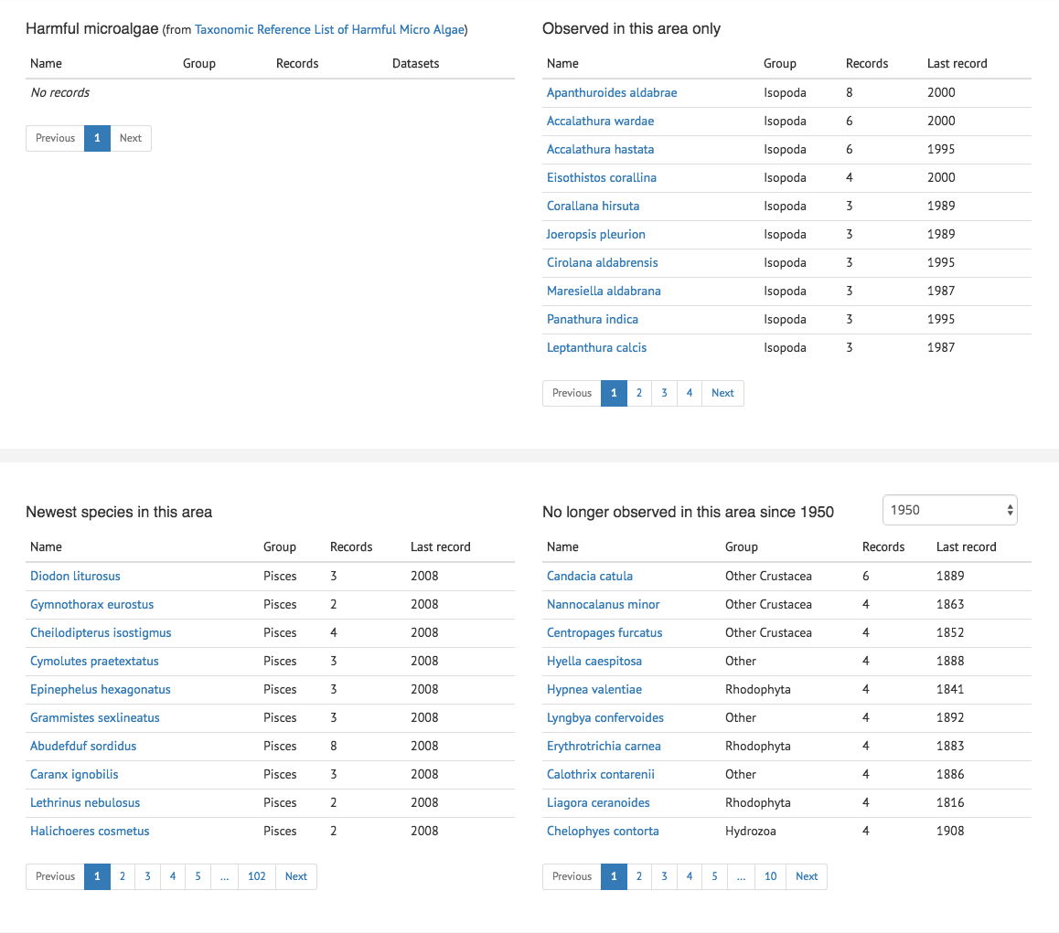
Notes:
Species that are unique, but also new species recordings and species that are no longer observed since for example 1950, so potentially disappeared.

Slide 24
Projects/grants
OBIS and BBNJ
Cruises
Researchers
The Technology and methodology for robust data integration, products, and services are already in place
Expanded properties to serve as a data and metadata Clearing-House mechanism
Flag data appropriate or inappropriate in a BBNJ context, including a measure of uncertainty
Network of >600 institutions, 27 OBIS nodes
The network need to expand, training and resources
Sampling event
Methods/
protocols
Institutes
Publications/applications
Notes:
OBIS has the foundational technology and methodology for robust data intregration, products and services that can support BBNJ. However, it can be further expanded to serve BBNJ not only as a data sharing platform and clearing house, but also include information around the sampling event, such as cruises, institutes, researchers, projects/grants, the applications and publications and the collection methods and protocols. OBIS should also allow annotations to the data, so data can be flagged as appropriate or inappropriate in a BBNJ - legal context, including a measure of uncertainty.
BBNJ can build on an existing network of >600 institutions world-wide, the expertise of 27 OBIS nodes, and a data coordination office under IOC. However, we still need to expand our network, to include more institutions and regions including the SIDS. This will require training and more resources.

